Slide 1
What is the level of subject matter knowledge?
What is a soybean?
How are soybeans manufactured?
What gives a soybean it’s characteristics including “traits”?
What is a multiplier?
What is a Point of Delivery?
Why is Brazil’s business drastically different from the US?
If you know nothing about the soybean “flow” in the US, that’s actually an advantage.

Slide 2
User Groups:
Growers
Dealers
Multipliers
Points of Delivery
Customer Care
Disque Intacta
Internal
And in the future, Trait Owners
Grower “Guillermo”
But the story does not start with Guillermo.
Plan | Buy | Plant | Grow | Harvest | Deliver | Sell

Slide 3
Dealer “Diego”
Buy | Sell
Grower “Guillermo”
Plan | Buy | Plant | Grow | Harvest | Deliver | Sell
But where does Diego get the soybeans to sell?

Slide 4
From an Obtainer
Multiplier “Mario”
Transfer to Other Multipliers
Plan | Acquire | Plant | Grow | Harvest | Clean, … Package | Sell
Dealer “Diego”
Buy | Sell
Grower “Guillermo”
Plan | Buy | Plant | Grow | Harvest | Deliver | Sell
Mario and Diego own their businesses.
They own the soybeans. (This is not an agency model.)
The transactions between them and growers are invoices in THEIR business systems, not in Value Capture/ITS.
They have contracts, though, to “cooperate” with the Value Capture process in selling Bayer products.

Slide 5
Grower “Guillermo”
Plan | Buy | Plant | Grow | Harvest | Deliver | Sell
Point of Delivery “Pedro”
Receive | Buy | Sell
This event looks like the end of the story, but this is where it really began.

Slide 6
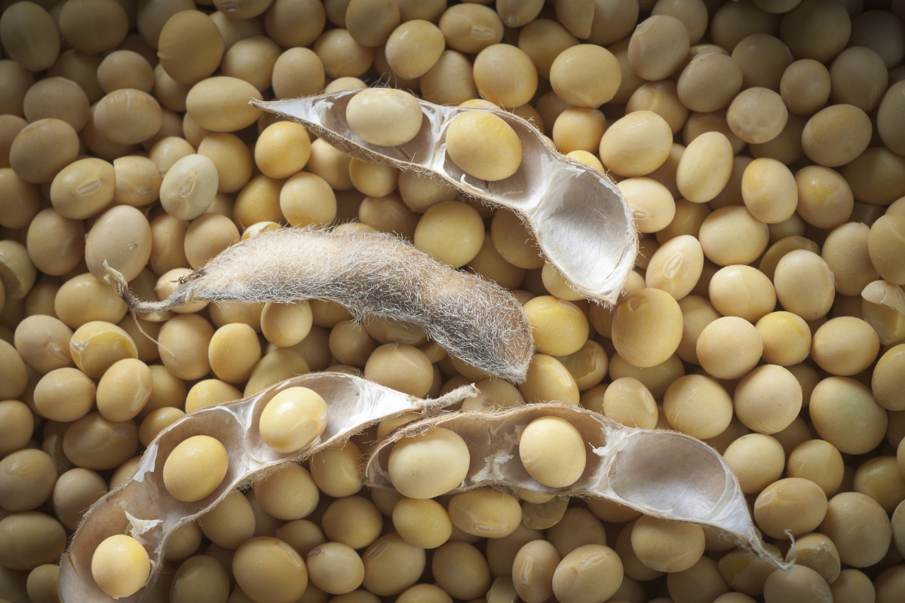
“Conventional” soybeans only get their characteristics from “parents” (which is really one plant that is both male and female, unlike corn). But we can optimize some genetics with “breeding” across plants.
Traited soybeans have characteristics like conventional soybeans but are also genetically modified to acquire DNA to have highly desired traits such as pest control, herbicide resistance, drought tolerance, etc.
The traits are “owned” by the technology companies who “found” them and figured out how to “insert” them.
The trait owner expects a grower to pay a percent of the value of that trait.
If the soybean is bought through a dealer or multiplier, the cost of the trait is included in the cost of the “bag”.
If the soybean is saved from a grower’s harvest and replanted the next season,……. The trait owner should still be paid.

Slide 7
Saved Seeds
Not allowed in the US!
Legal in Brazil and other countries.
Guillermo does not
deliver all his harvest. Some is saved for planting.
Grower “Guillermo”
Plan | Buy | Plant | Grow | Harvest | Deliver | Sell
Plan | Buy | Plant | Grow
Point of Delivery “Pedro”
Receive | Buy | Sell
Legally Saved Seeds
Guillermo registers the soybeans saved from his harvest and pays a bank slip for the value of the trait in those soybeans.
Illegally Saved Seeds
Guillermo simply plants the saved seeds.
How does the trait owner get paid?
Answer – we catch him at the Point of Delivery which requires a complex chain or events throughout the whole process.

Slide 8
2 fundamental “concepts” (intangible things we invented)
Think of these like an account, like a bank account.
 | Quota (for multipliers and dealers) | Credits (for growers)
Meaning | It is a quantity value equal to the KG (weight) of what is owned and “can be sold”. Quota starts with multipliers but can be moved to dealers. | It is a quantity value equal to the KG (weight) of what can be delivered to a POD as “certified” seed (meaning the owner has already paid for the trait). Only growers have credits.
Creation | When a multiplier finishes his processes and puts commercially-ready soybeans in LOTS, quota is created. | When a multiplier or dealer sells to a grower, the quota is “converted” to credits. It’s a complex formula to estimate the seeds the grower will harvest from the purchased seeds.
Flow | Quota in first owned by the multiplier who created it. If can move to dealers when a dealer purchases seed from a multiplier. It can move to another multiplier when a transfer happens. | MOST credits come from “Sales” but there are many other transactions that create credits. Credits are “consumed” when a grower delivers his harvest to the POD.

Slide 9
This is where I’ll switch to the other presentation that focuses on duplication of data, triggers and checkpoints, and “where is the truth”

Slide 10
If we need to go deeper, we can talk about these:
Timing issues with moving quota.
“Quota Requests”
Calculations for creating Credits.
Fixing the estimation used to calculate credits.
Other ways to gain or loose credits (See Grower “Extract”)
Returns (outside the system)
Expiration of credits
Blocking and unblocking credits
Any much more
But let’s get back to the end of the story, the event that started all of this.

Slide 11
But let’s get back to the end of the story, the event that started all of this.
How do we “catch” the illegally saved seeds at time of delivery?
A grower who purchased certified seeds and
A grower who saved seeds and registered them and paid a bank slip
WILL HAVE CREDITS at the time of delivery.
Their credits will “cover” the seeds they bring to the POD.
Growers who illegally saved seeds will not have credits.
They will have “uncovered” seeds.
So 2 things happen at POD:
Test the soybeans for the trait(s)
Check the growers credits

Slide 12
Grower “declares” the truck contains Intacta seeds
POD weighs the seeds, logs the transaction in the POD’s system
POD opens the grower’s credits account and consumes the volume delivered.
Tests “negative” for Intacta
POD weighs the seeds, logs the transaction in the POD’s system
Grower “declares” the truck has no Intacta seeds
POD takes samples from the truck and tests for Intacta.
Tests “positive” for Intacta
So, what happens when the grower does not have enough credits to “cover” the delivered volume?

Slide 13
What happens when the grower does not have enough credits to “cover” the delivered volume?
No, the grower’s account does not go negative. This is where it gets more complicated.
When the POD sees that the grower has insufficient credits…..
The POD is supposed to consume all available credits so the grower’s balance goes to zero.
The POD add the grower to “the list” of growers who have uncovered seeds at their location.
But there are many variations to what actually happens
Regardless, each POD has some way of knowing which growers are short on credits for what has already been delivered.
The story finally ends when the grower calls the POD and says “I want to sell my seeds.”

Slide 14




POD user will check if the grower is on “the list”.
If not, there is no need to check ITS.
Grower calls POD to sell his beans
POD user will check if the grower has new credits
POD’s System
ITS System
In the case of new credits, the POD needs to consume those in ITS and update “the list”.
This might take the grower off “the list” or at least reduce the volume/kg for the grower on “the list”.
POD User

Slide 15
In the case of a delivery of totally illegally saved seeds when the grower has no credits,
The price must be “fixed”.
POD user will register the sale, but not at the price-of-the-day.
The POD will “charge” the grower 7.5% for Intacta royalties (reducing how much the grower is paid).
POD user will check if the grower has credits and there are none.
Grower calls POD to sell his beans
POD’s System
ITS System
Royalties are then paid to Bayer.
And the story ends.
POD user will also update “the list” per the volume sold in that transaction.
POD User

Slide 16
What we did not talk about:
Growers delivering to multiple PODs
Grower License Agreements
RR, both of them ;-)
Cooperators who provide land for multipliers
A farmer is a “grower” when they plant seed they purchase.
A farmer is a “cooperator” when they plant seed that belongs to a multiplier.
When the next trait is commercialized …..
And it belongs to Bayer
And it belongs to Corteva or Syngenta
3 stages of multiplication
Approval Workflows
Edits vs. Adjustments
Dealer to Dealer Sales
And much more

